Slide 1
JOINTS, LOCKING & UNLOCKING OF KNEE & ARCH OF FOOT
OF
LOWER LIMB

Slide 2
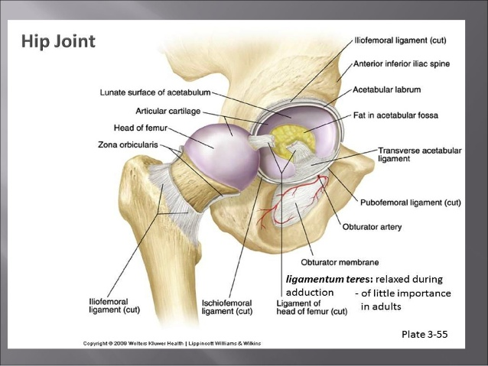
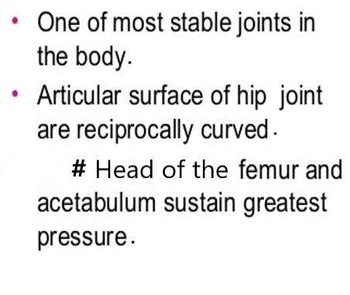
HIPJOINT

Slide 3
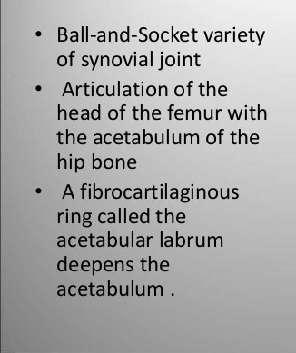
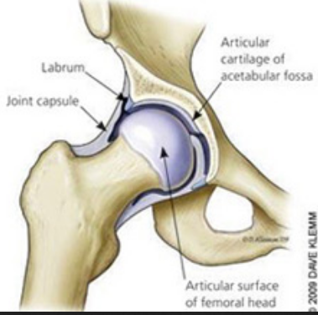
Type & Articulation of Hip Joint

Slide 4
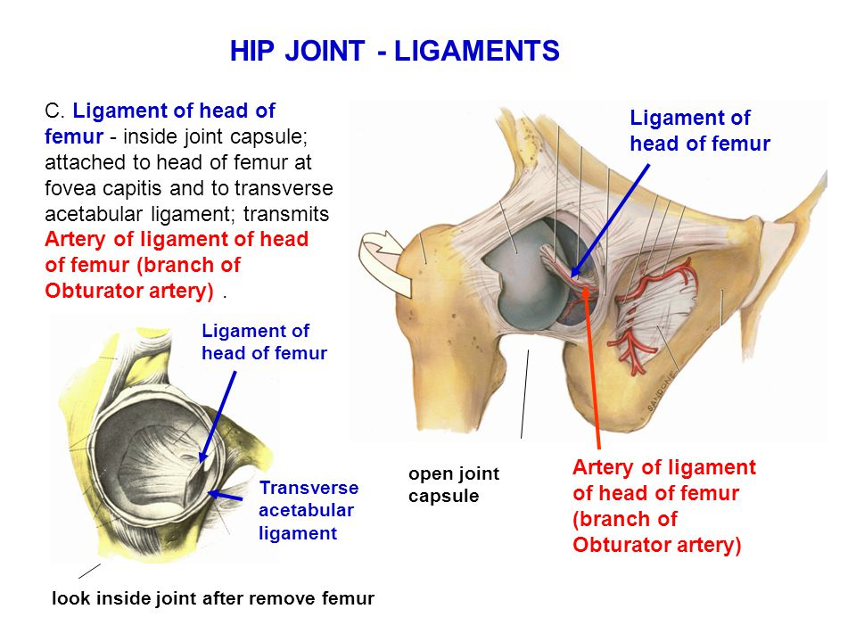
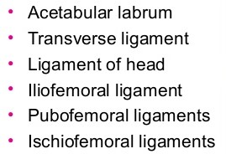
Ligaments of Hip Joint

Slide 5
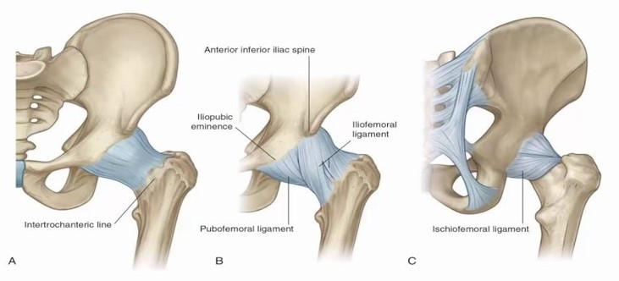
Ligaments of Hip Joint

Slide 6
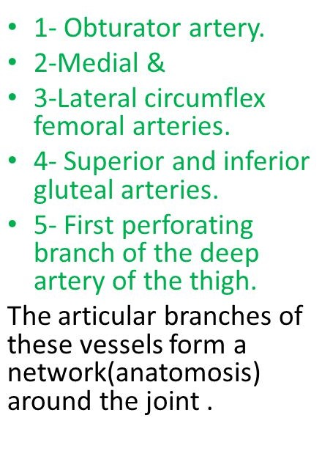
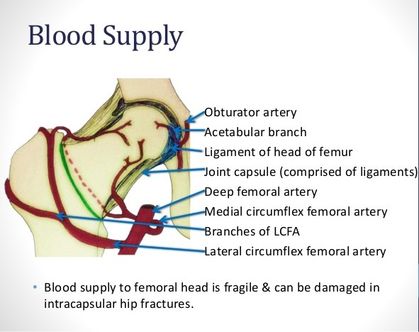
Blood Supply of Hip Joint

Slide 7
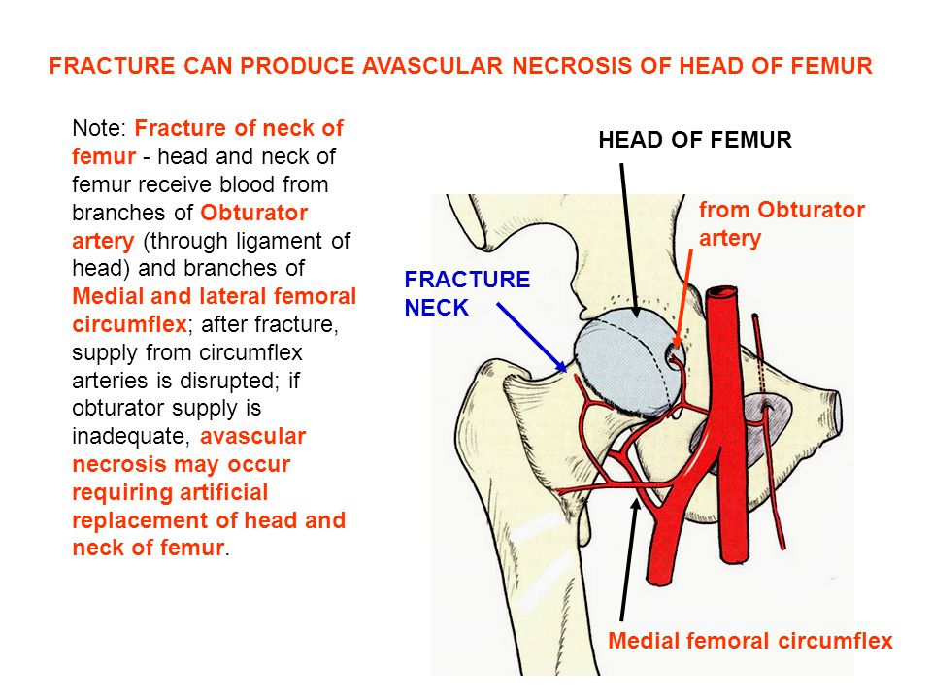
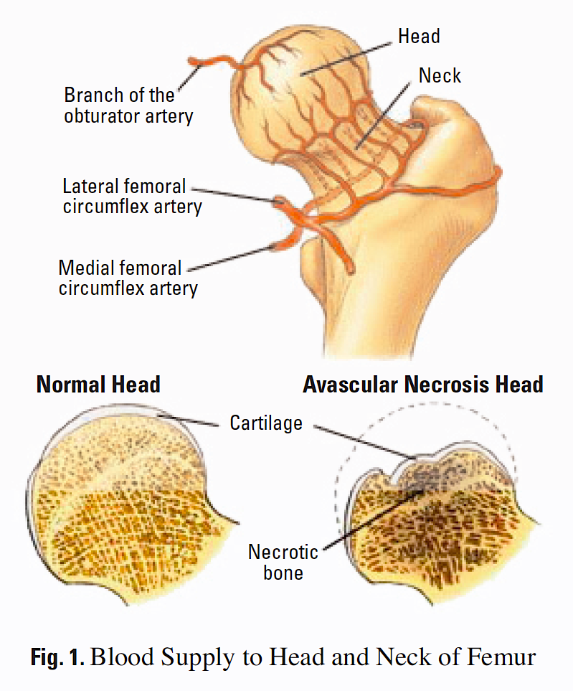
Avascular Necrosis of Head of Femur

Slide 8
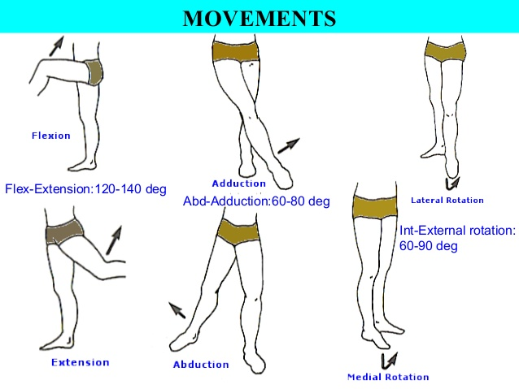
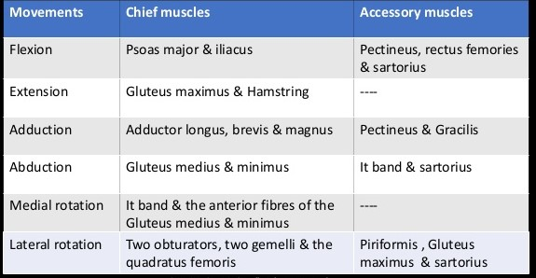
Movements & Muscles Producing Movements of Hip Joint

Slide 9
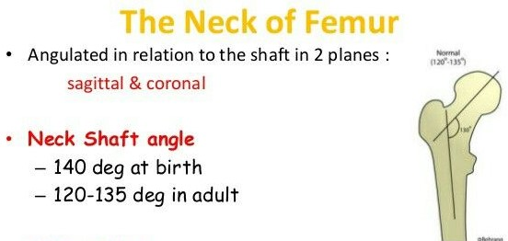
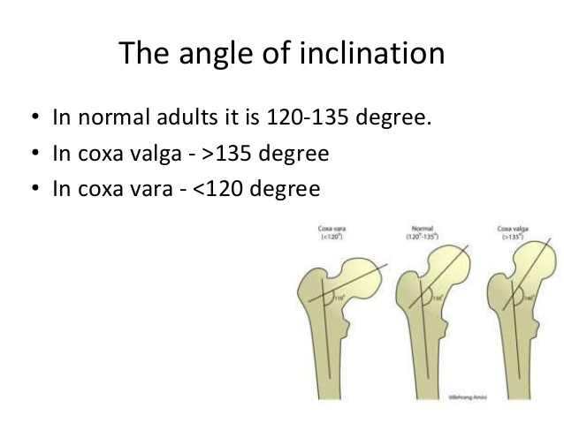
Neck Shaft Angle & Coxa Vara Coxa Valga

Slide 10
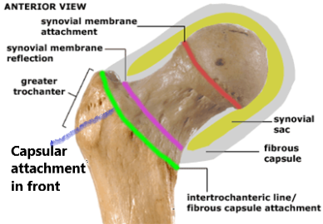
Capsular Attachment of Hip Joint
Capsular ligament is attached to the upper end of the femur. It starts from the front of the neck in a continuous line along the intertrochanteric line up to the lower margin of the neck medially……

Slide 11
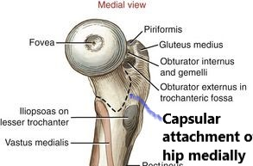
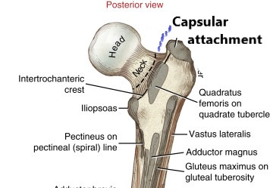
Capsular Attachment of Hip Joint
Then runs above and backward from in front of the lesser trochanter then it run to the posterior surface
of the neck 1cm in front from the intertrochanteric crest up to the upper margin of the neck near the root of the greater trochanter.

Slide 12
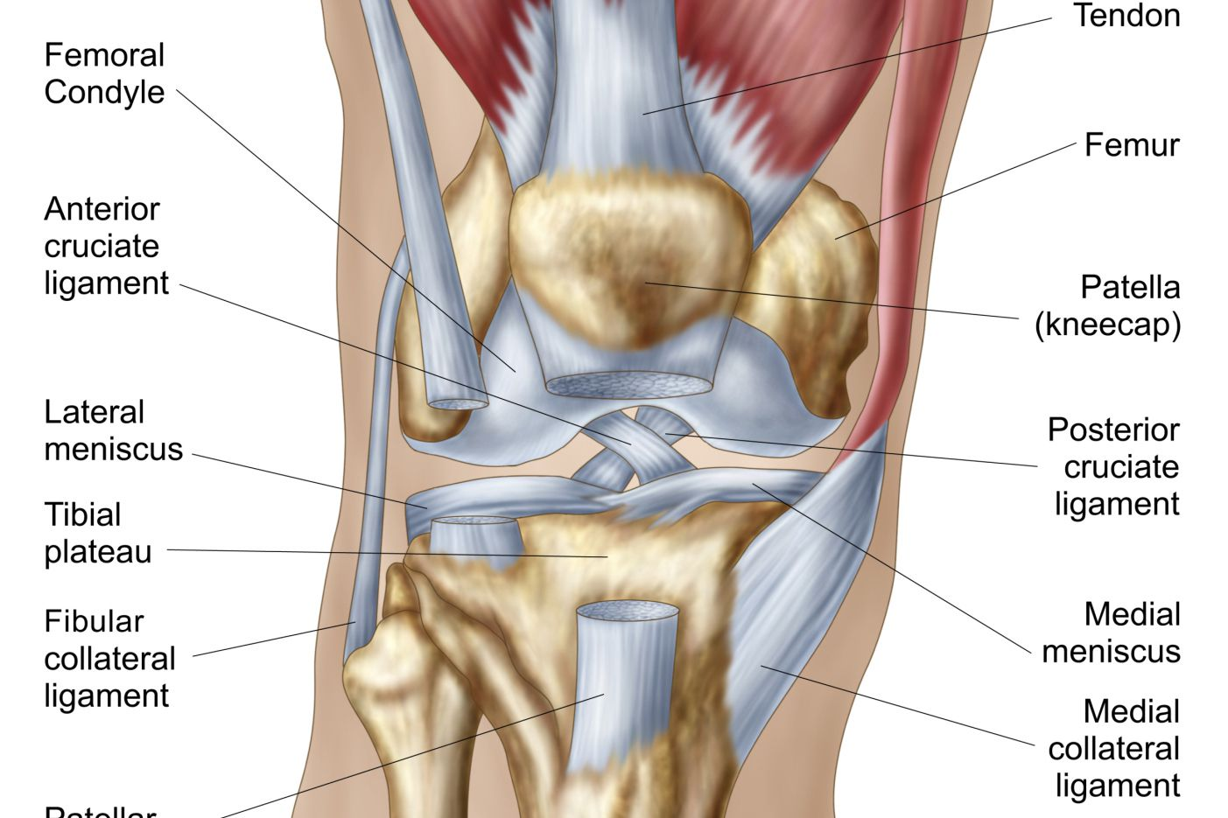
Knee Joint
Type – Complex compound type of synovial joint. Biaxial joint according to axis.
Articular surface – Two condyles & patellar surface of femur articulate with two condyles of tibia & patellar posterior articular surface.
Why complex – A joints divided into two compartments by an articular disc or meniscus also presence of intra articular ligaments & muscle.
Why compound – More than two articular bones are involved sharing a common articular capsule.
Within the knee joint there are 2 other joints-
Tibiofemoral joint – Condylar type of synovial joint.
Femoropatellar joint – Saddle type of synovial joint.

Slide 13
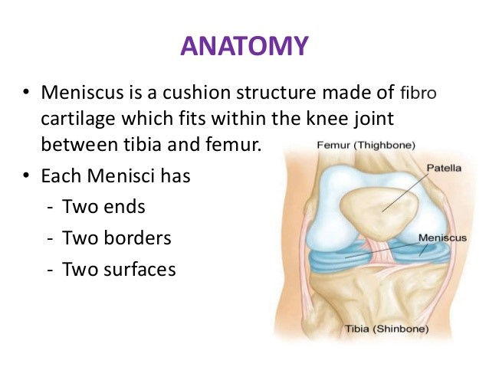
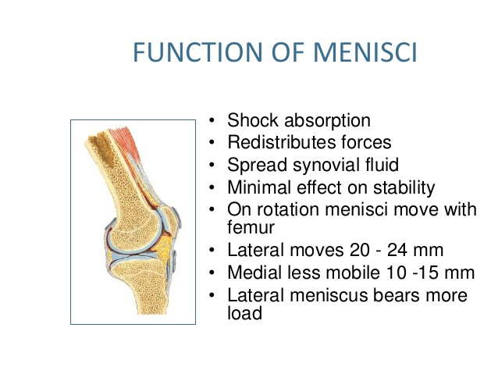
Menisci & Its Function

Slide 14
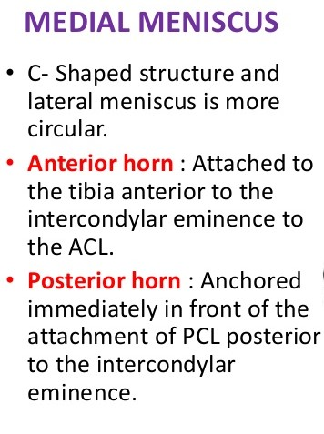
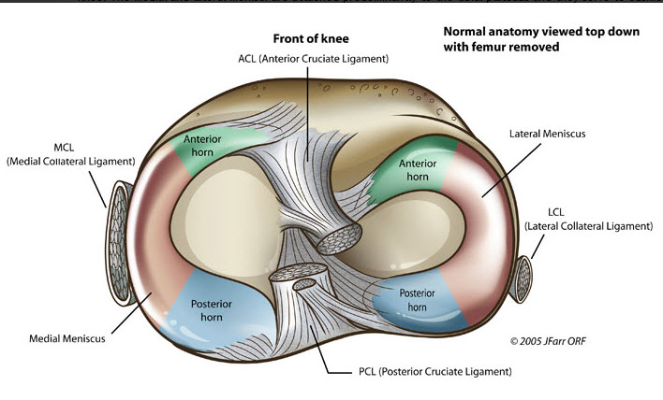
Medial Meniscus

Slide 15
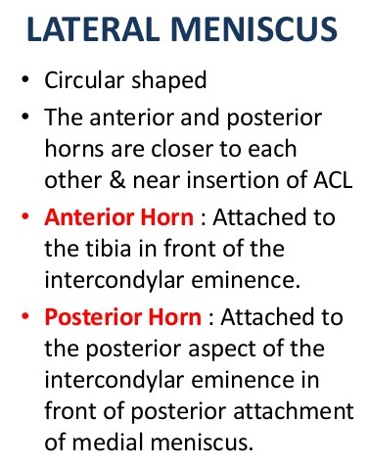
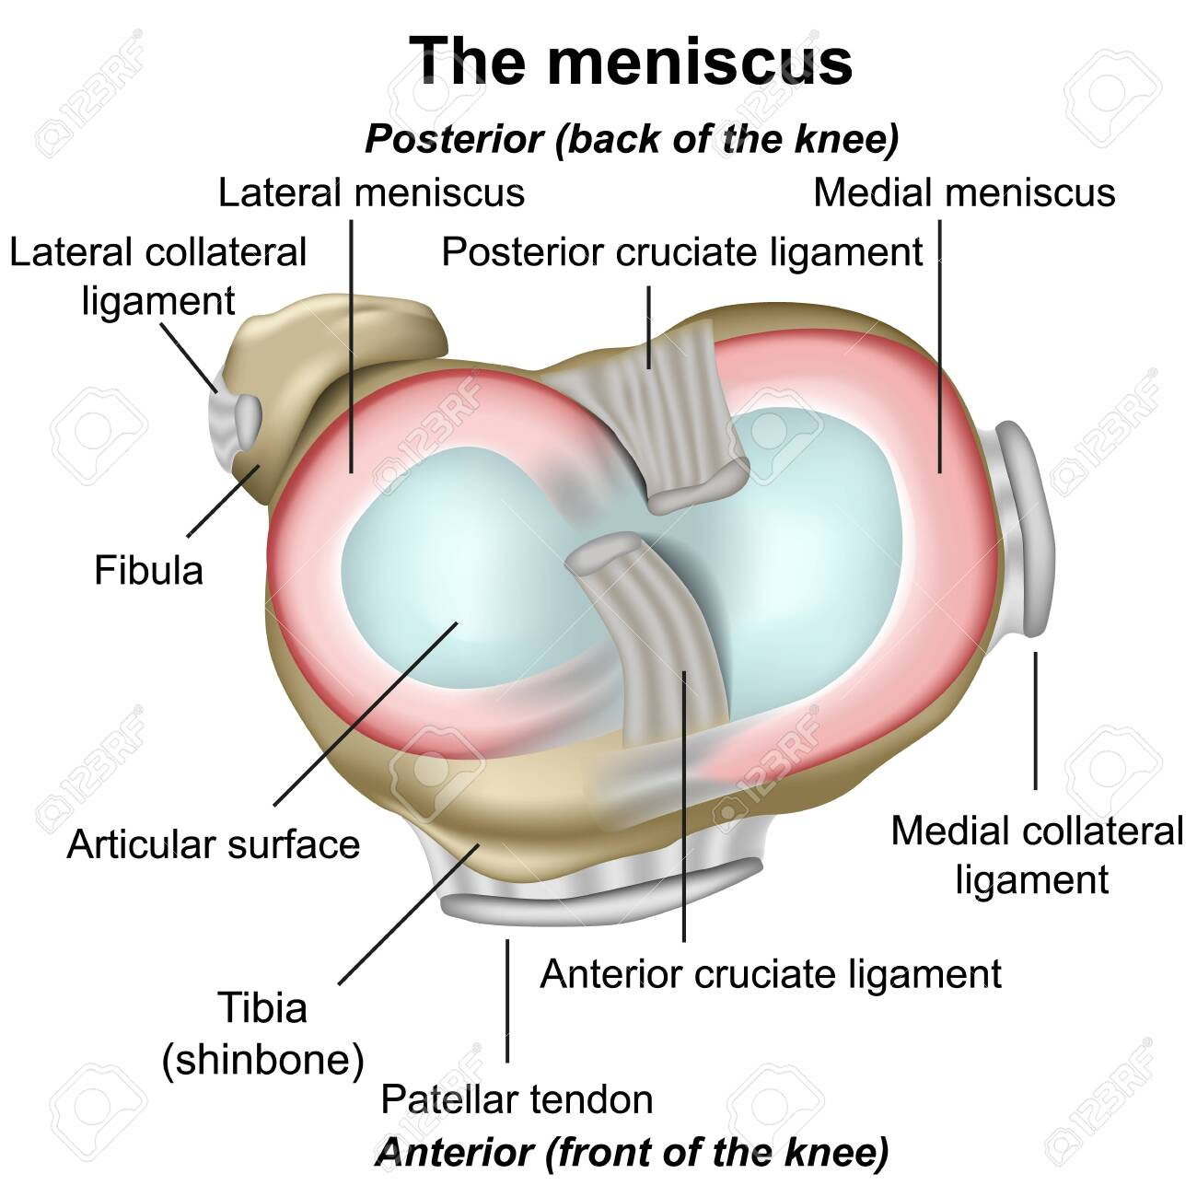
Lateral Meniscus

Slide 16
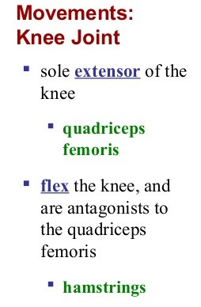
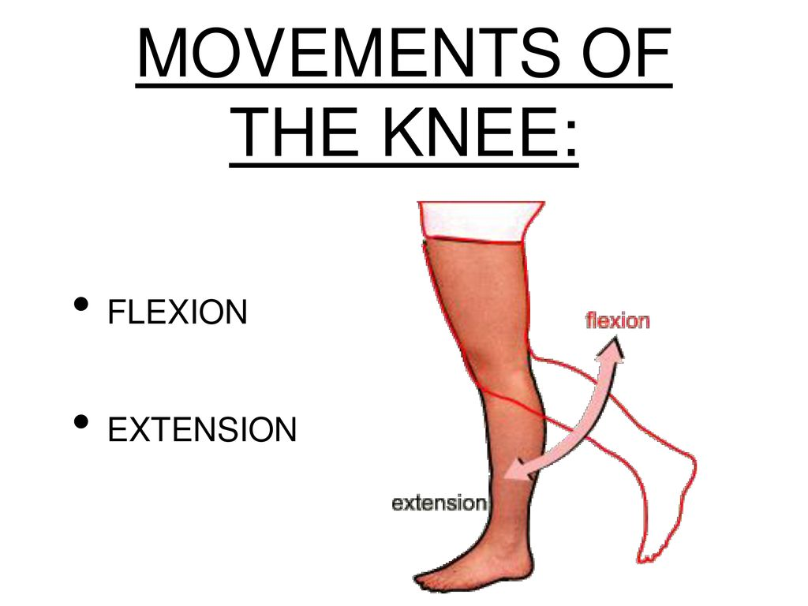
Movements & Muscles Producing Movements of Knee Joint

Slide 17
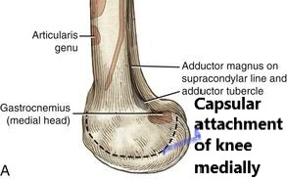
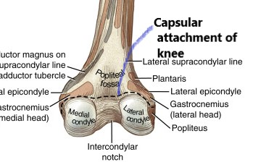
Capsular Attachment of Knee Joint
It attached to the lower end of the femur. It starts from the medial surface of the medial condyle. Then runs below and backwards avoiding the adductor tubercle.
And runs along the upper border of the intercondylar notch then it runs over the lateral condyle…..

Slide 18
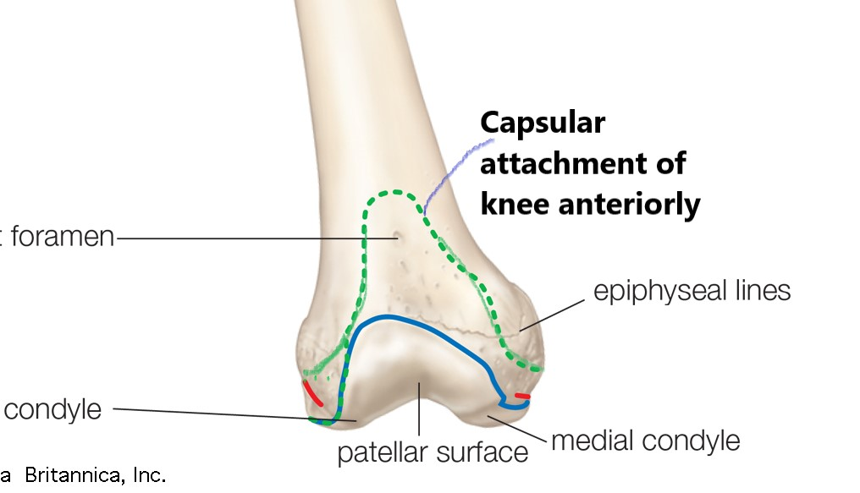
Capsular Attachment of Knee Joint
And cover the popliteal groove then it runs forward and upward in the anterior aspect of the femur. Anteriorly, the capsule is deficit.

Slide 19
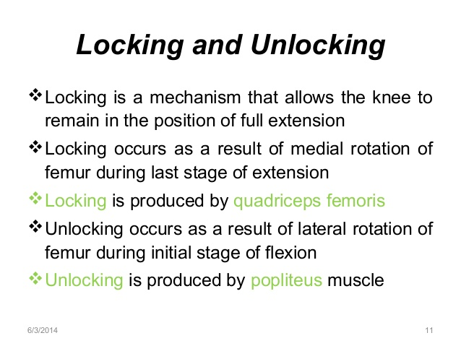
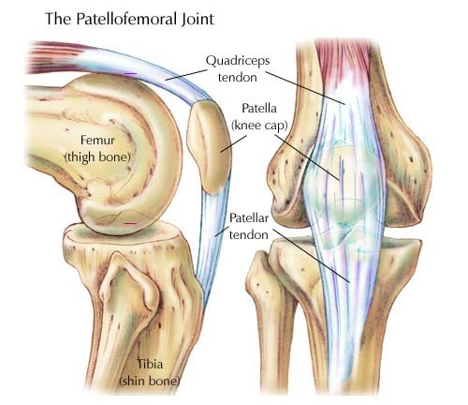
Locking & Unlocking of Knee Joint

Slide 20
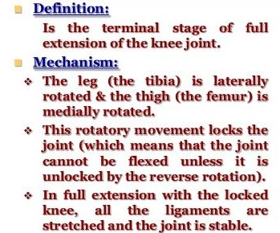
Locking of Knee Joint

Slide 21
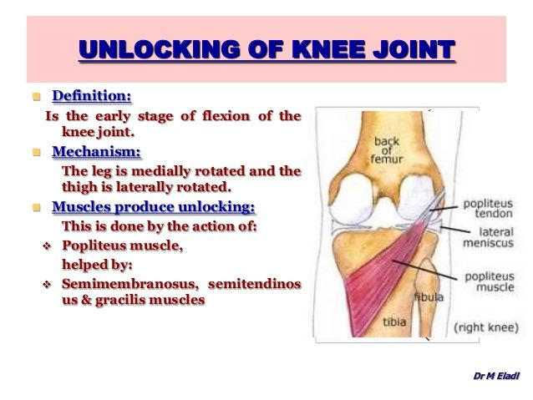
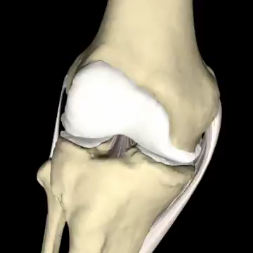
Unlocking of Knee Joint

Slide 22

Mechanism of Locking & Unlocking of Knee

Slide 23
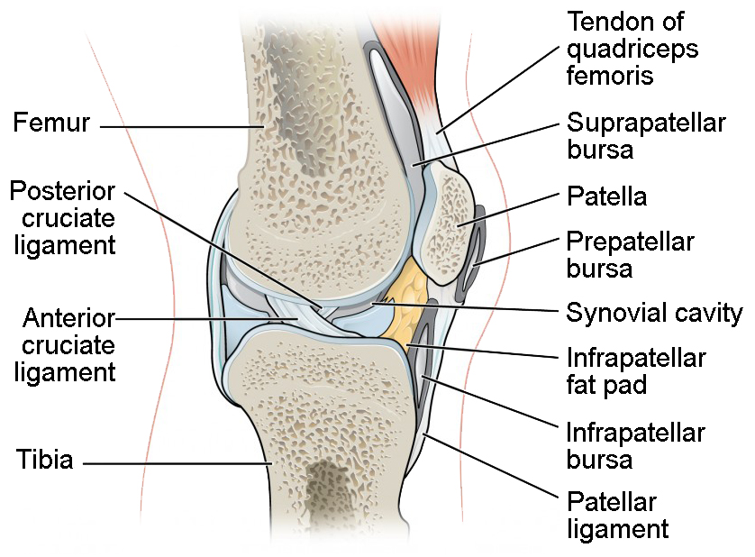
Bursa Around The Knee Joint
Prepatellar bursa(subcutaneous)
Infrapatellar bursa (subcutaneous)
Infrapatellar bursa(deep)
Suprapatellar bursa(deep)

Slide 24
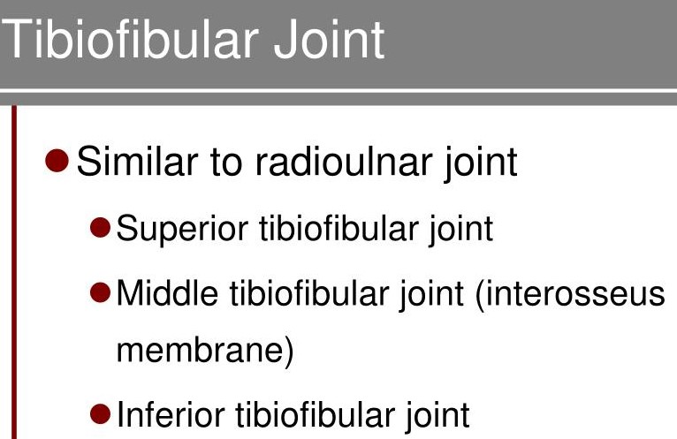
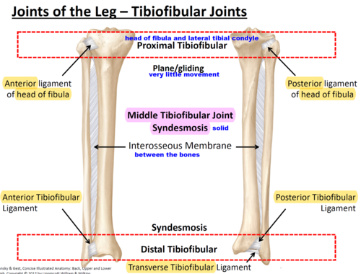
Tibiofibular Joints

Slide 25
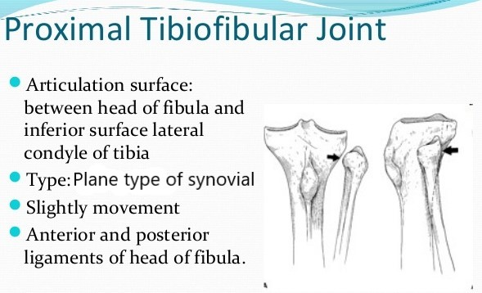
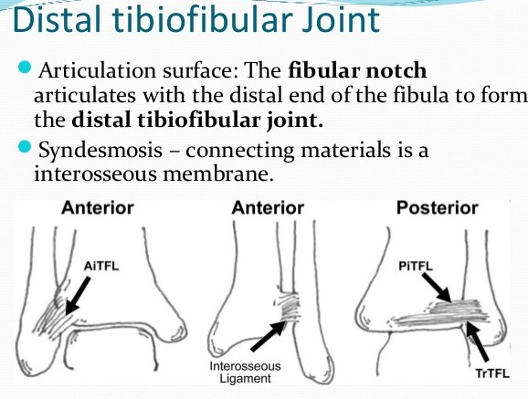
Superior & Inferior Tibiofibular Joint

Slide 26
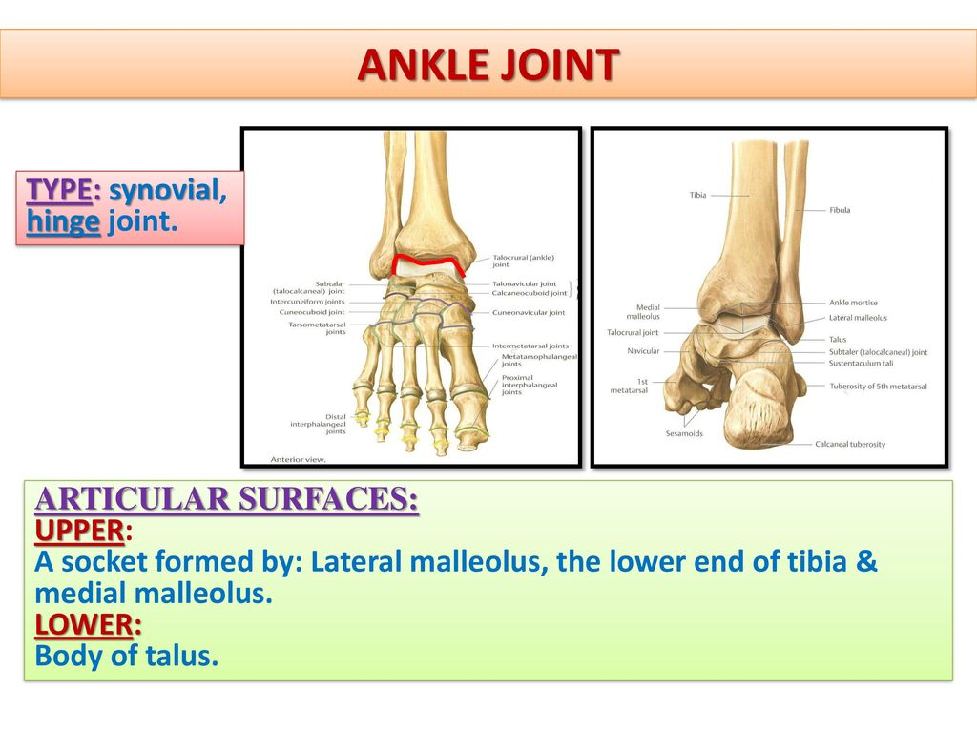
Ankle Joint

Slide 27
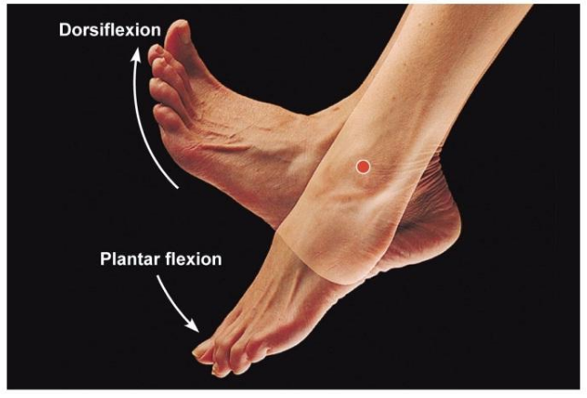
Movements of Ankle Joint
Dorsiflexion – It is the movement of the ankle joint, where the foot is elevated and the angle between dorsum of the foot and anterior surface of the leg become decreased that is known as dorsiflexion it is a true flexion.
Planter flexion – It is the movement of the ankle joint where the foot is depressed or moves downward and backward and the angle between the dorsum of the foot and anterior surface of the leg increased that is known as planter flexion.

Slide 28
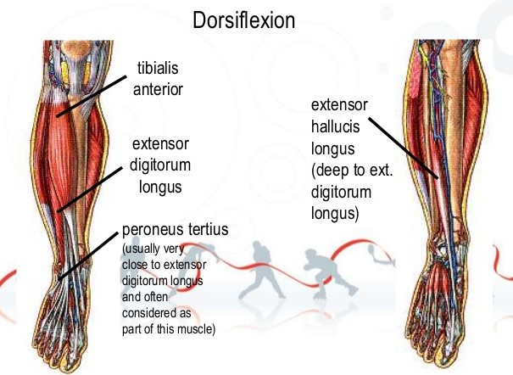
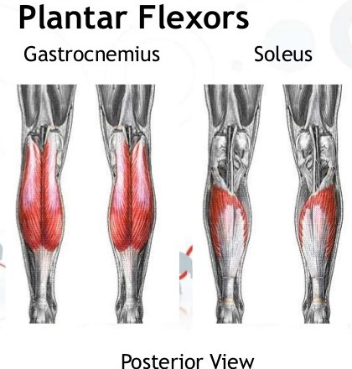
Muscles Producing Movements of Ankle Joint

Slide 29
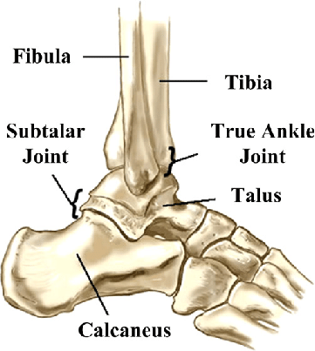
Subtalar Joint
Type – Plane type of synovial joint.
Articular surface – Inferior articular surface of the talus articulate with the superior articular surface of the calcaneus.

Slide 30
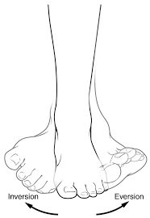
Movements of Subtalar Joint
Inversion – it is the movement of subtalar joint, when the medial border of the foot directed upwards and sole of the foot directed medially that is known as inversion.
Eversion – it is the movement of subtalar joint, when the lateral border of the foot directed upwards and sole of the foot directed laterally that is known as eversion.

Slide 31
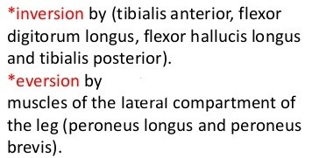
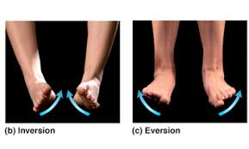
Muscles Producing Movements of Subtalar Joint

Slide 32
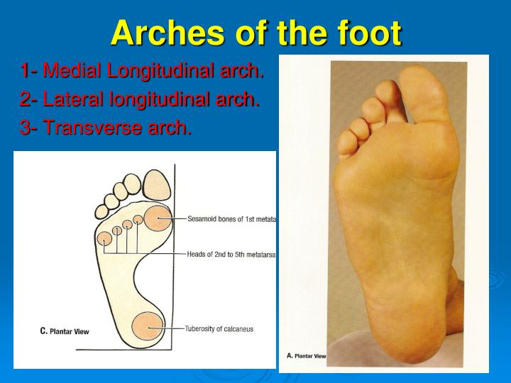
Arch of the foot

Slide 33
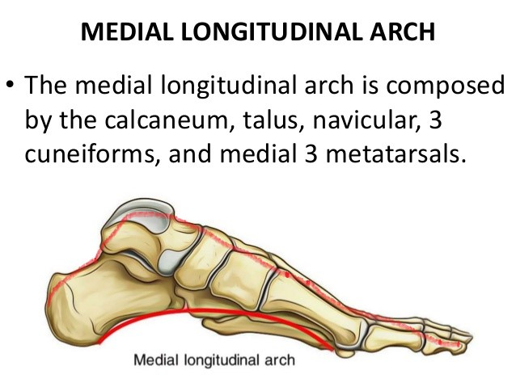
Formation of Medial Longitudinal Arch
This arch is higher & more mobile. It is formed by –
Ends – anterior end is formed by heads of 1st , 2nd & 3rd metatarsal. Posterior end is formed by medial tubercle of calcaneum.
Summit – It is formed by the superior articular surface of the talus.
Pillars – Anterior pillar is formed by the talus, navicular, 3 cuneiform & 1st 3 metatarsal bones – it is long & weak. Posterior pillar short & strong is formed by medial half of the calcaneum.

Slide 34

Formation of Lateral Longitudinal Arch
This arch is low & has limited mobility. It is formed by –
Ends – anterior end is formed by heads of 4th & 5th metatarsal. Posterior end is formed by lateral tubercle of calcaneum.
Summit – It is formed by the superior articular surface of the calcaneum.
Pillars – Anterior pillar is formed by the cuboid & 4th & 5th metatarsal bones – it is long & weak. Posterior pillar short & strong is formed by lateral half of the calcaneum.

Slide 35


Transverse Arch

Slide 36

Functions of The Arches

Slide 37


Factors Maintaining The Arches

Slide 38
THANK YOU

