Slide 1
MANDIBLE
HEAD & NECK

Slide 2
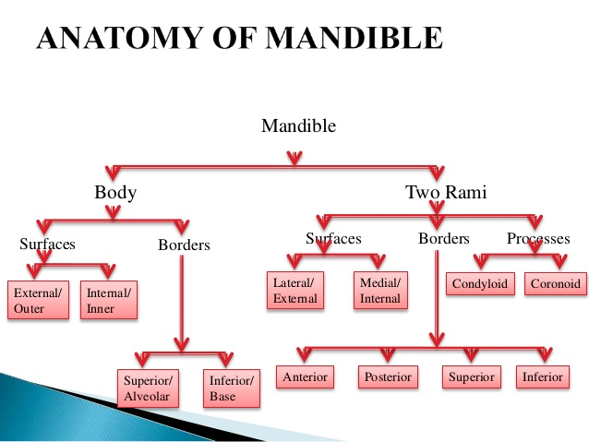

Slide 3
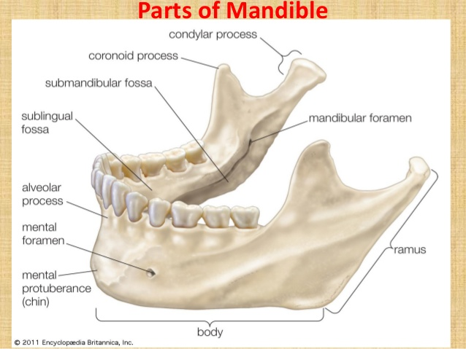

Slide 4
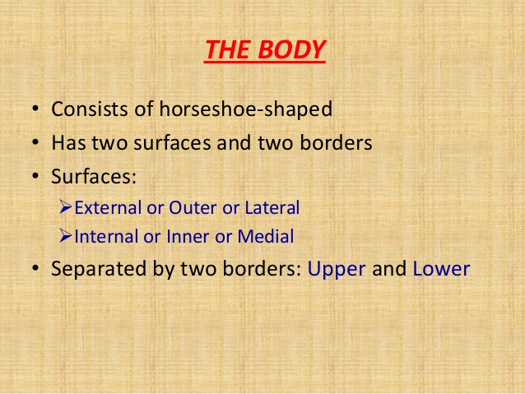

Slide 5
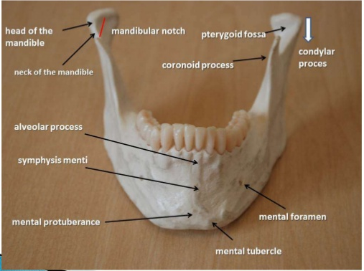
MANDIBLE

Slide 6
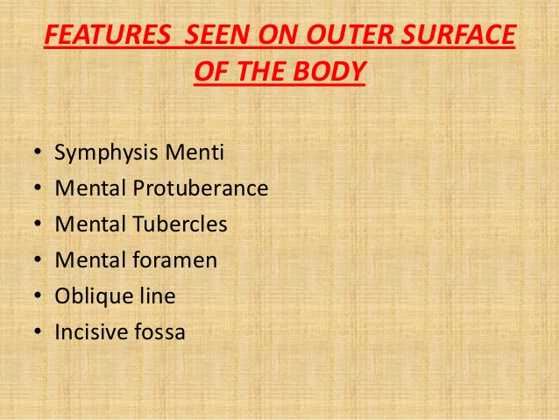

Slide 7
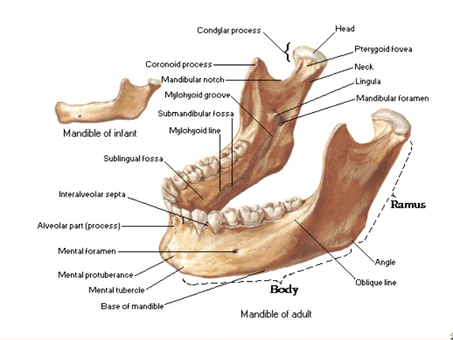
FEATURES OF MANDIBLE

Slide 8
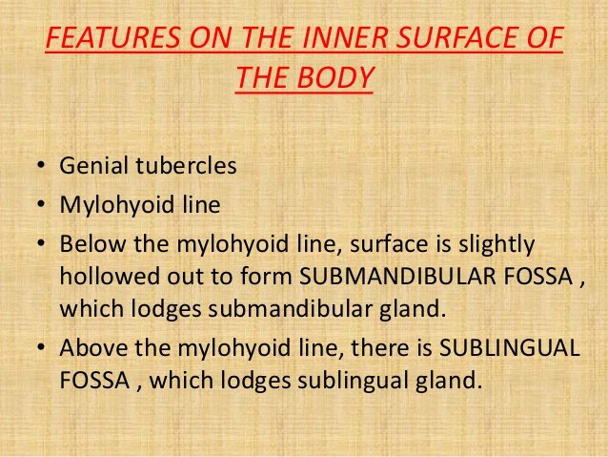

Slide 9
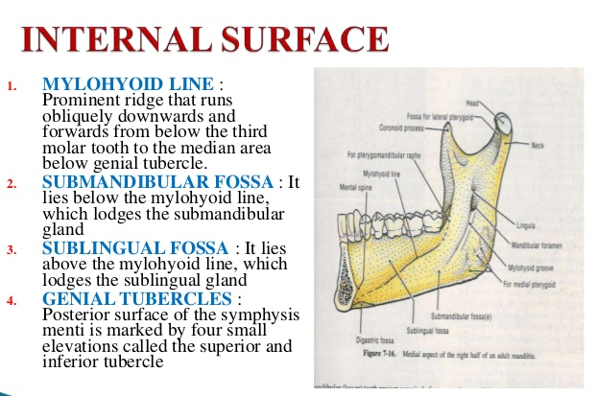

Slide 10
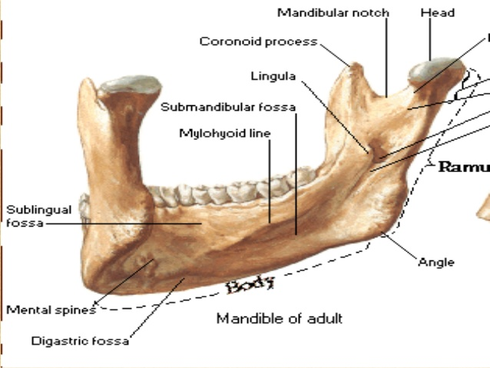
FEATURES OF INTERNAL SURFACE

Slide 11
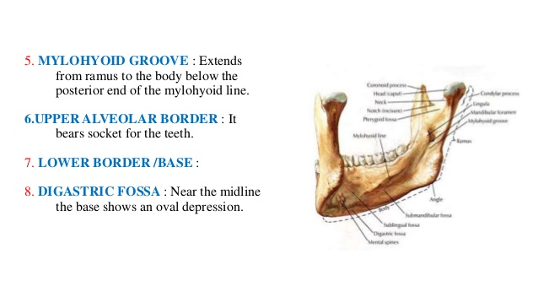
INTERNAL SURFAFE

Slide 12
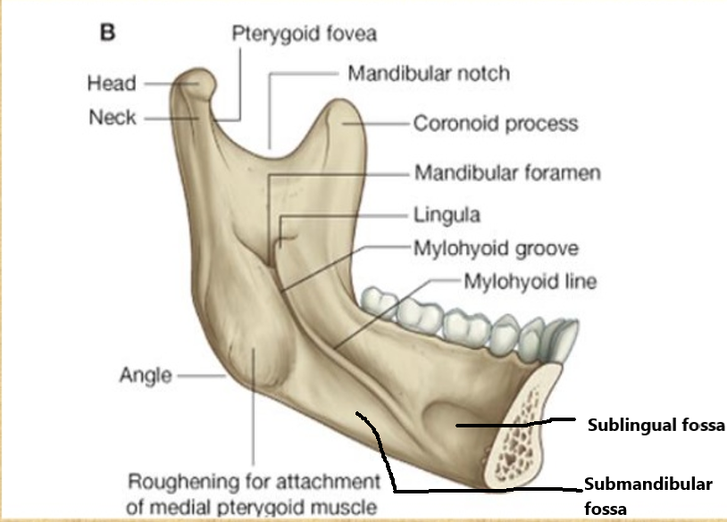
FEATURES OF INTERNAL SURFACE

Slide 13
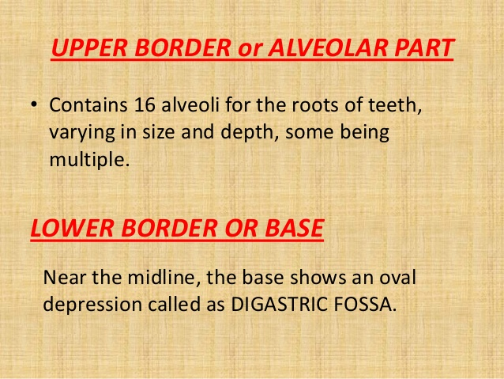

Slide 14
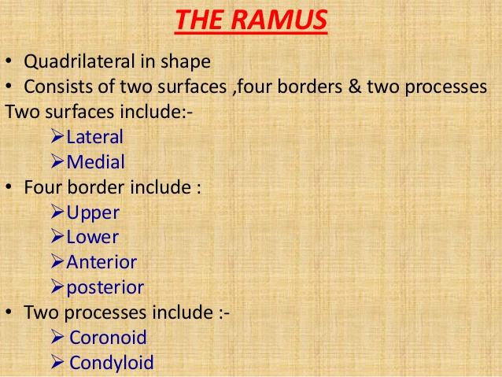

Slide 15
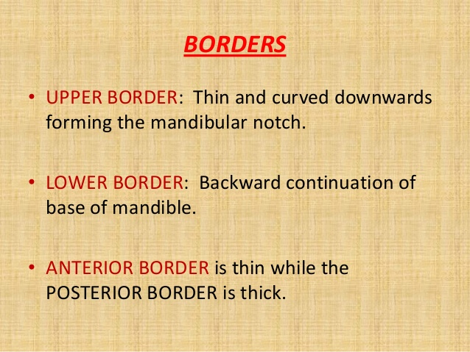

Slide 16
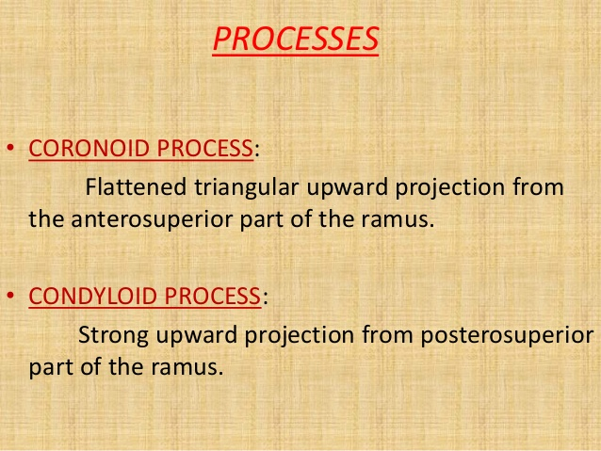

Slide 17
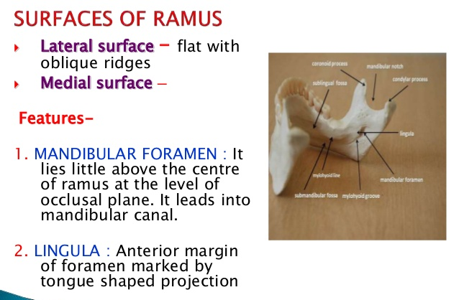

Slide 18
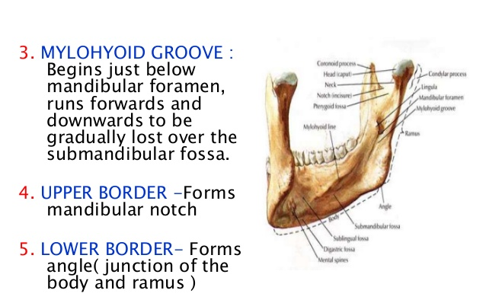
INNER SURFACE OF RAMUS

Slide 19
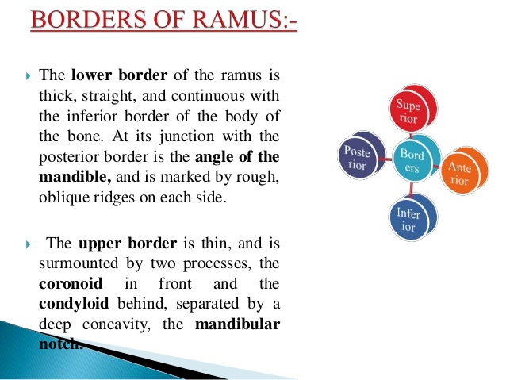

Slide 20
FEATURES OF MANDIBLE

Slide 21
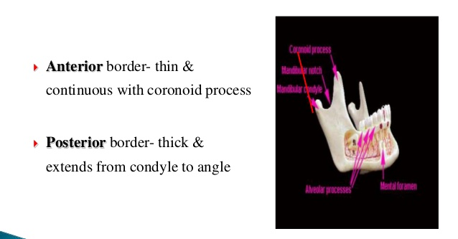
RAMUS

Slide 22
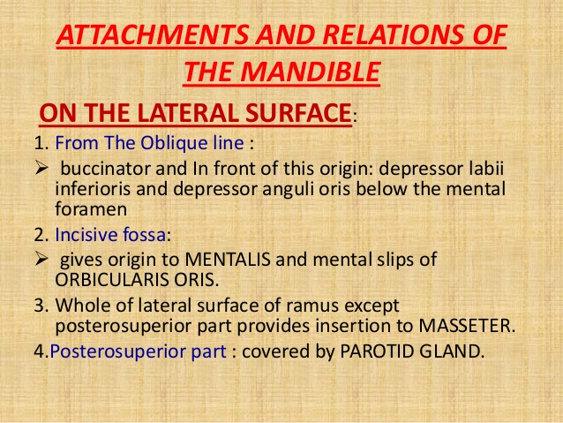

Slide 23
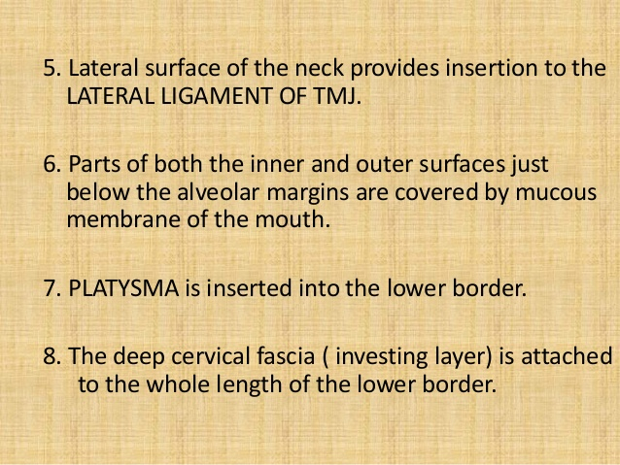

Slide 24
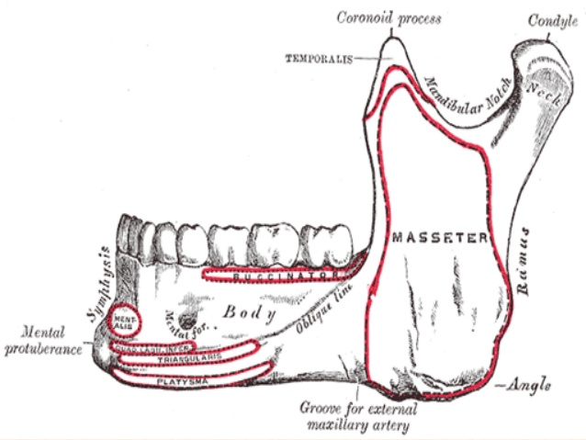
MUSCLE ATTACHMENT OF EXTERNAL SURFACE

Slide 25
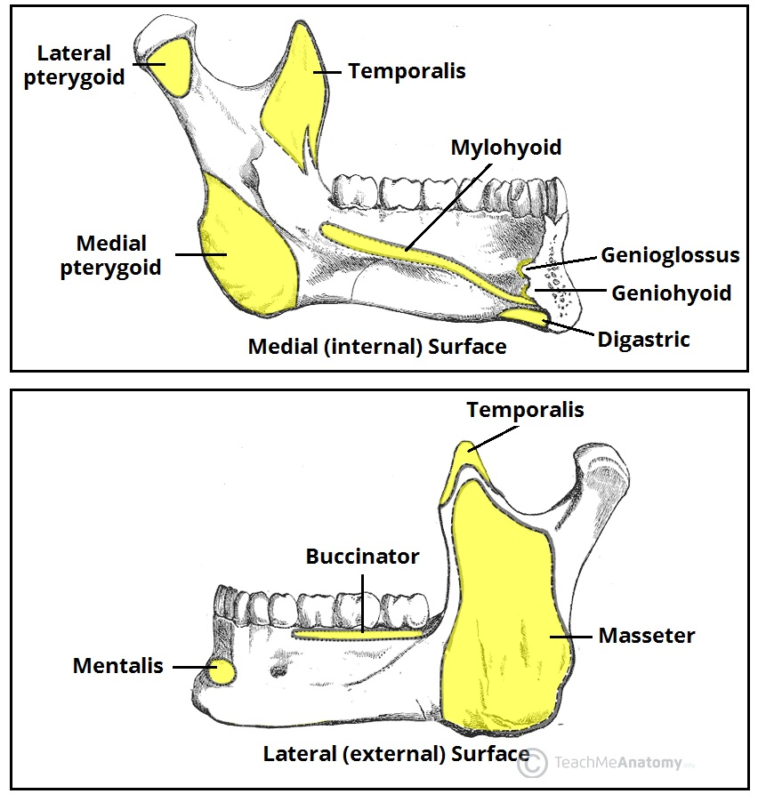
MUSCLE ATTACHMENT OF MANDIBLE

Slide 26
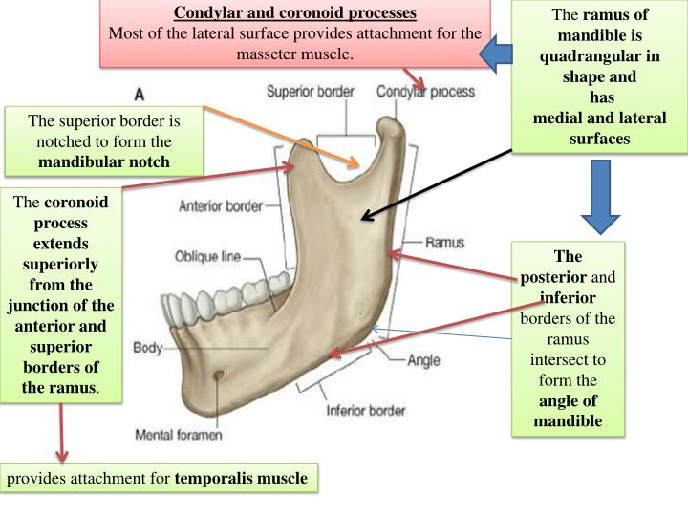
FEATURES OF EXTERNAL SURFACE

Slide 27
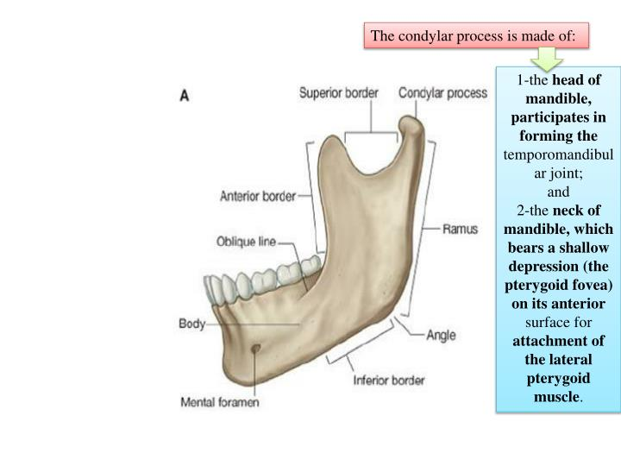
FEATURES OF EXTERNAL SURFACE

Slide 28
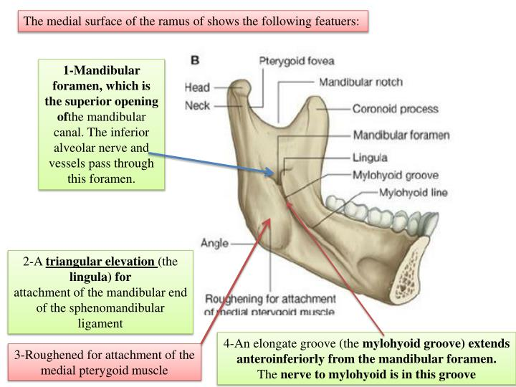
FEATURES OF INTERNAL SURFACE

Slide 29
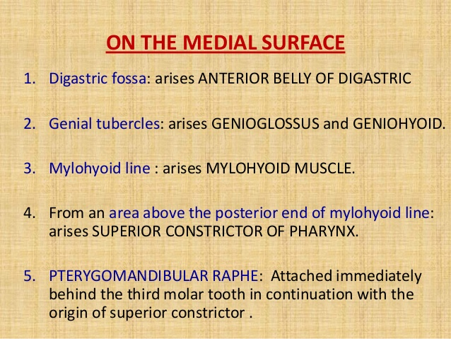

Slide 30
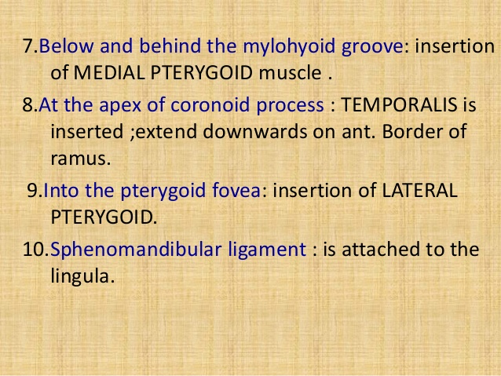
MUSCLE ATTACHMENT OF INTERNAL SURFACE

Slide 31
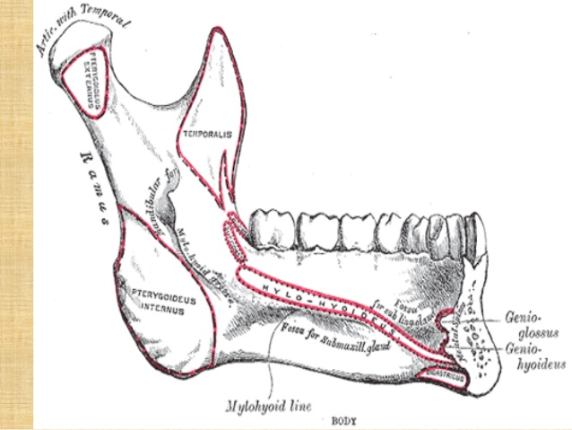
MUSCLE ATTACHMENT OF INTERNAL SURFACE

Slide 32
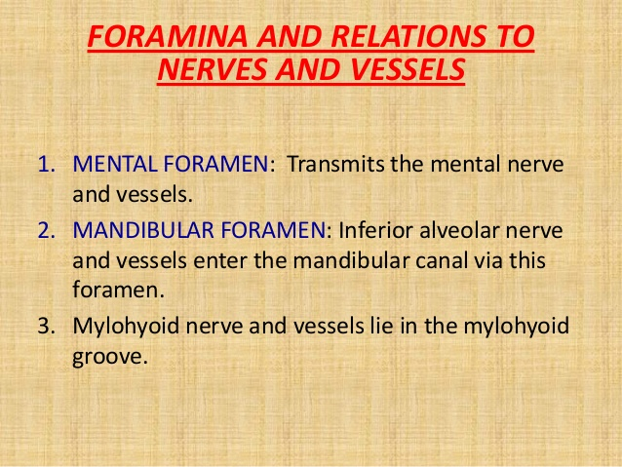

Slide 33
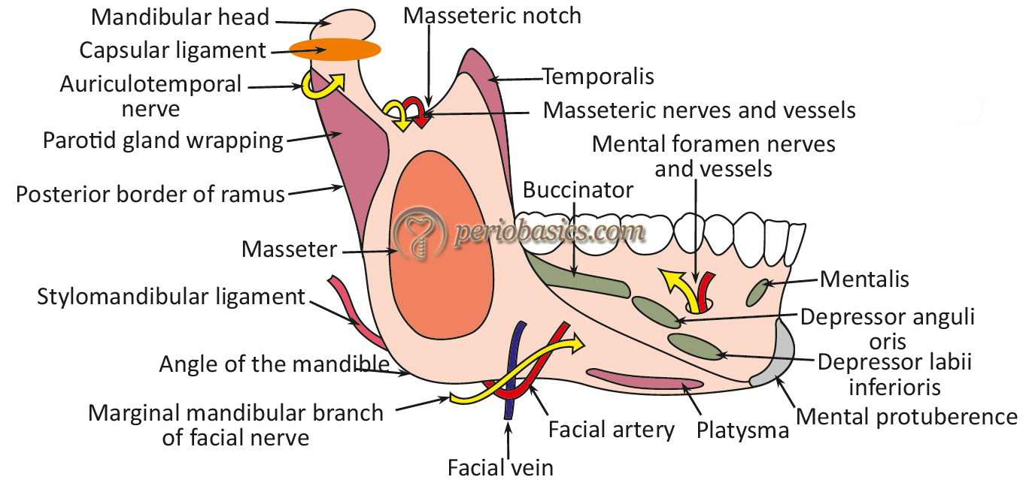
RELATIONS & ATTACHMENT OF EXTERNAL SURFACE

Slide 34
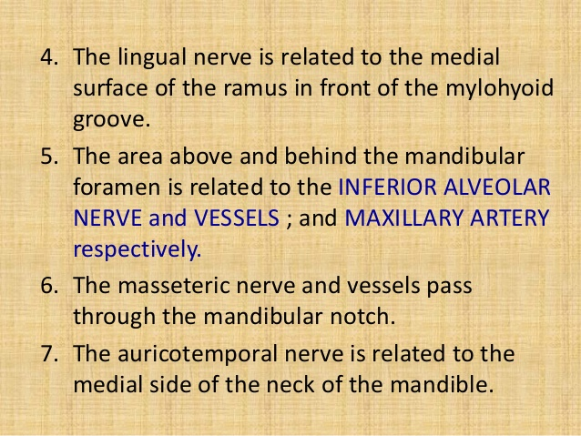
RELATIONS OF NERVES & VESSELS

Slide 35
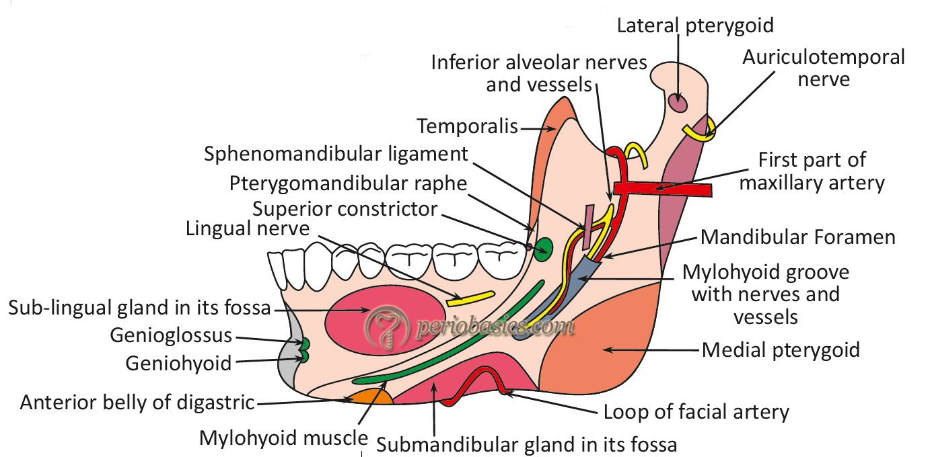
RELATIONS & ATTACHMENT OF INTERNAL SURFACE

Slide 36
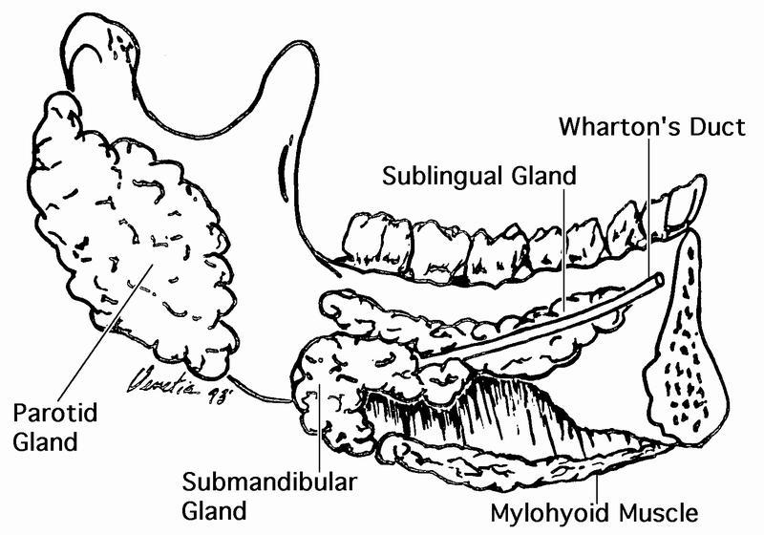
RELATION OF SALIVARY GLANDS WITH MANDIBLE

Slide 37
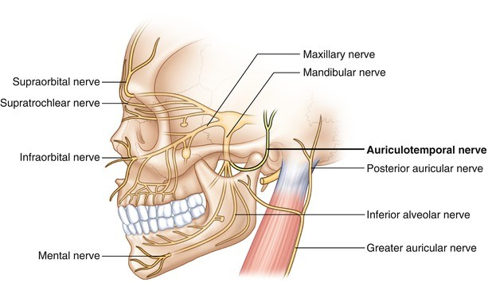
RELATION OF NERVES WITH MANDIBLE

Slide 38
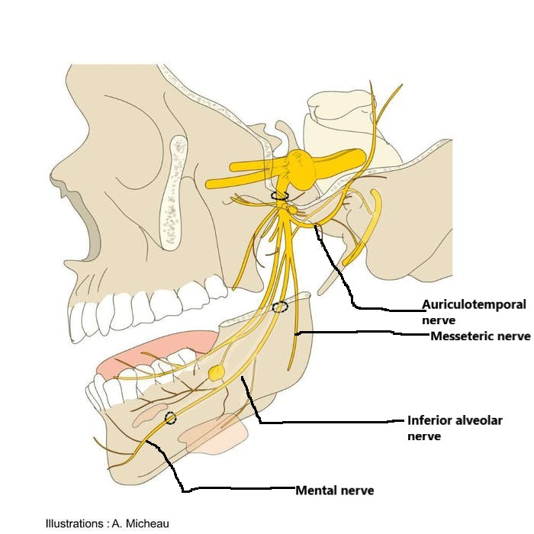
RELATION OF NERVES WITH MANDIBLE

Slide 39
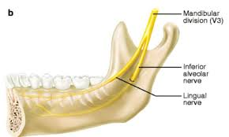
RELATION OF NERVE IN INTERNAL SURFACE

Slide 40
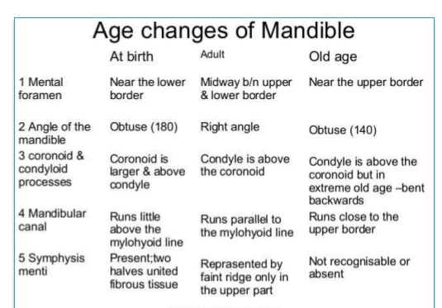

Slide 41
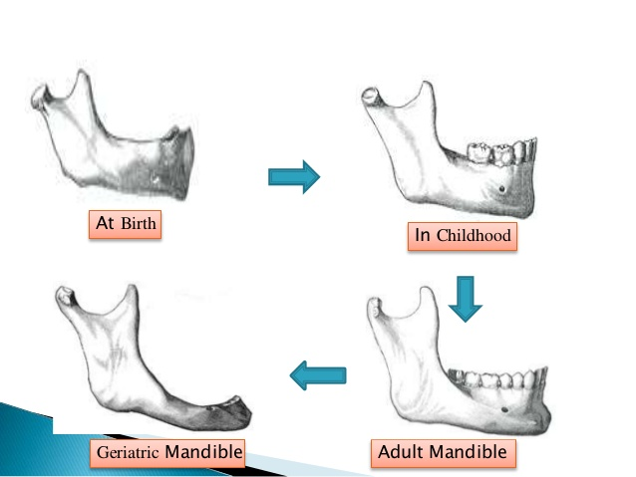
AGE CHANGES OF MANDIBLE

Slide 42
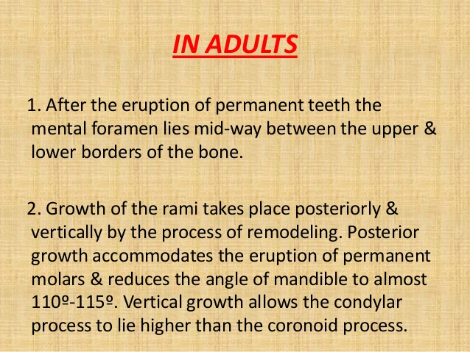
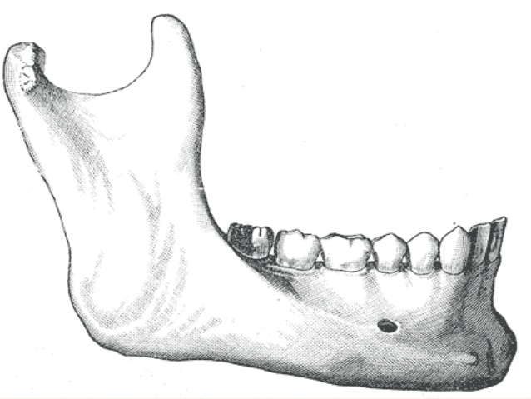

Slide 43
