Slide 1
Occipital bone & sphenoid bone
HEAD & NECK

Slide 4
EXTERNAL SURFACE OF SQUAMOUS PART OF OCCIPITAL BONE

Slide 5
INTERNAL SURFACE OF SQUAMOUS PART OF OCCIPITAL BONE

Slide 6
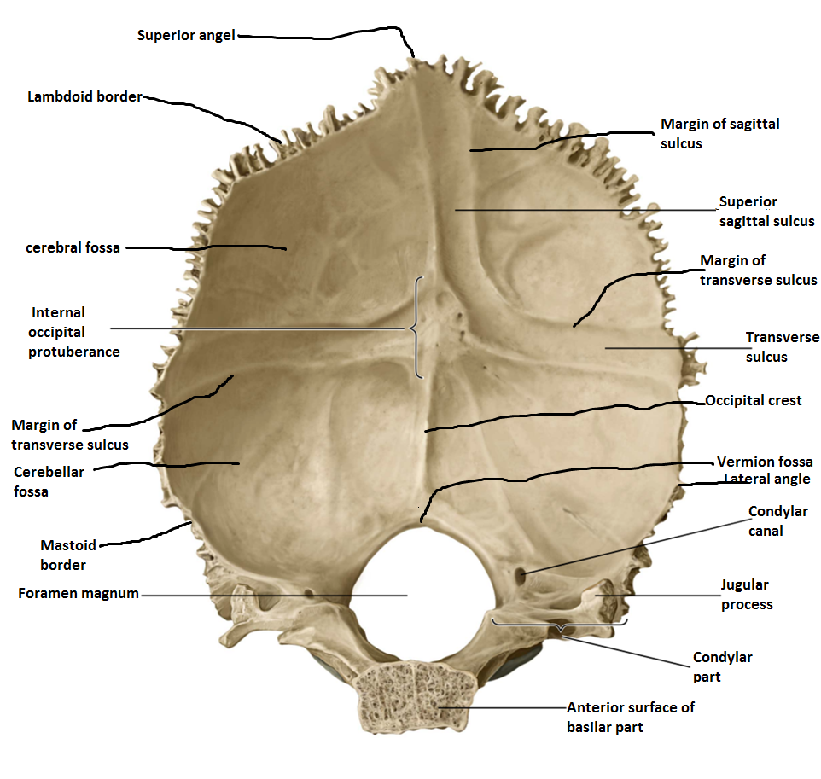
INTERNAL SURFACE OF OCCIPITAL BONE

Slide 8
INTERNAL SURFACE OF BASILAR PART, CONDYLAR PART OF OCCIPITAL BONE

Slide 9
EXTERNAL SURFACE OF BASILAR PART & CONDYLAR PART OF OCCIPITAL BONE

Slide 11
INTERNAL SURFACE OF SQUAMOUS PART OF OCCIPITAL BONE

Slide 13
ATTACHMENT OF OCCIPITAL BONE

Slide 18
SUPERIOR SURFACE OF BODY OF SPHENOID BONE

Slide 19
SUPERIOR SURFACE OF BODY OF SPHENOID BONE

Slide 20
FEATURES OF SUPERIOR SURFACE

Slide 21
INFERIOR SURFACE OF BODY SPHENOID BONE

Slide 22
INFERIOR SURFACE OF BODY OF SPHENOID BONE

Slide 23
SPHENOID BONE

Slide 24
LATERAL SURFACE OF BODY SPHENOID BONE

Slide 25
LATERAL SURFACE OF BODY OF SPHENOID BONE

Slide 26
LATERAL SURFACE OF BODY OF SPHENOID BONE

Slide 28
ANTERIOR SURFACE OF BODY SPHENOID BONE

Slide 30
POSTERIOR SURFACE OF BODY OF SPHENOID BONE

Slide 33
CEREBRAL SURFACE OF GREATER WING OF SPHENOID BONE

Slide 36
ORBITAL SURFACE OF GREATER WING OF SPHENOID BONE

Slide 37
LESSER WING OF SPHENOID BONE

Slide 38
LESSER WING OF SPHENOID BONE

Slide 40
PTERYGOID PROCESSES OF SPHENOID BONE

Slide 41
PTERYGOID PROCESSES

